Slide 1
F2 Pet Food
Platform Development Plan 2024
Tong Bi | tongbi@andrew.cmu.edu Zhengao Chen | zhengaoc@andrew.cmu.edu
Cris Guo ｜ yiyuang@andrew.cmu.edu Fei Xia | fxia2@andrew.cmu.edu

Slide 2
AGENDA
Vision
Problem
Product
Market
Business Model
Competition
Go-to-Market

Slide 3
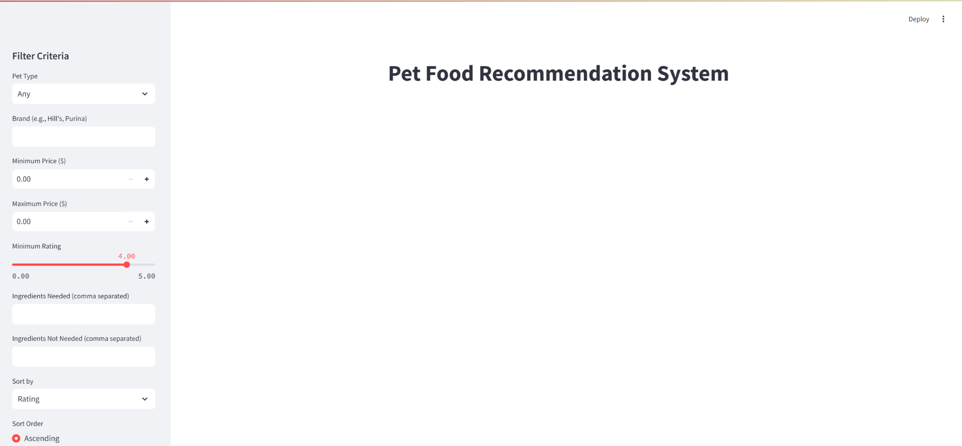
VISION

Slide 4
VISION
Make pet nutrition accessible, informed, and fully customized.

Slide 5
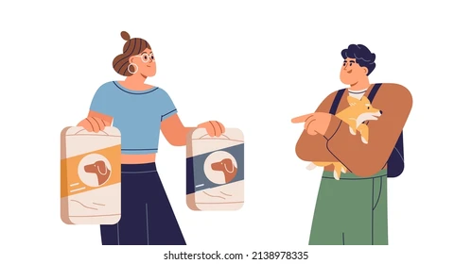
VISION
personalized nutrition plans：
transparency in nutritional information
budget-friendly：
real-time pricing and local availability

Slide 6
PROBLEM
What is the customer pain point?
Personalized Needs
Overwhelming Choices
Cost-Effectiveness
Health Risks

Slide 7
PROBLEM current solution
Consulting Veterinarians
Online Research
Trial and Error

Slide 8
PROBLEM
How much does it cost?
Expensive
Wasteful
Why is it broken?
Lack of Personalization
High Cost and Inconvenience

Slide 9
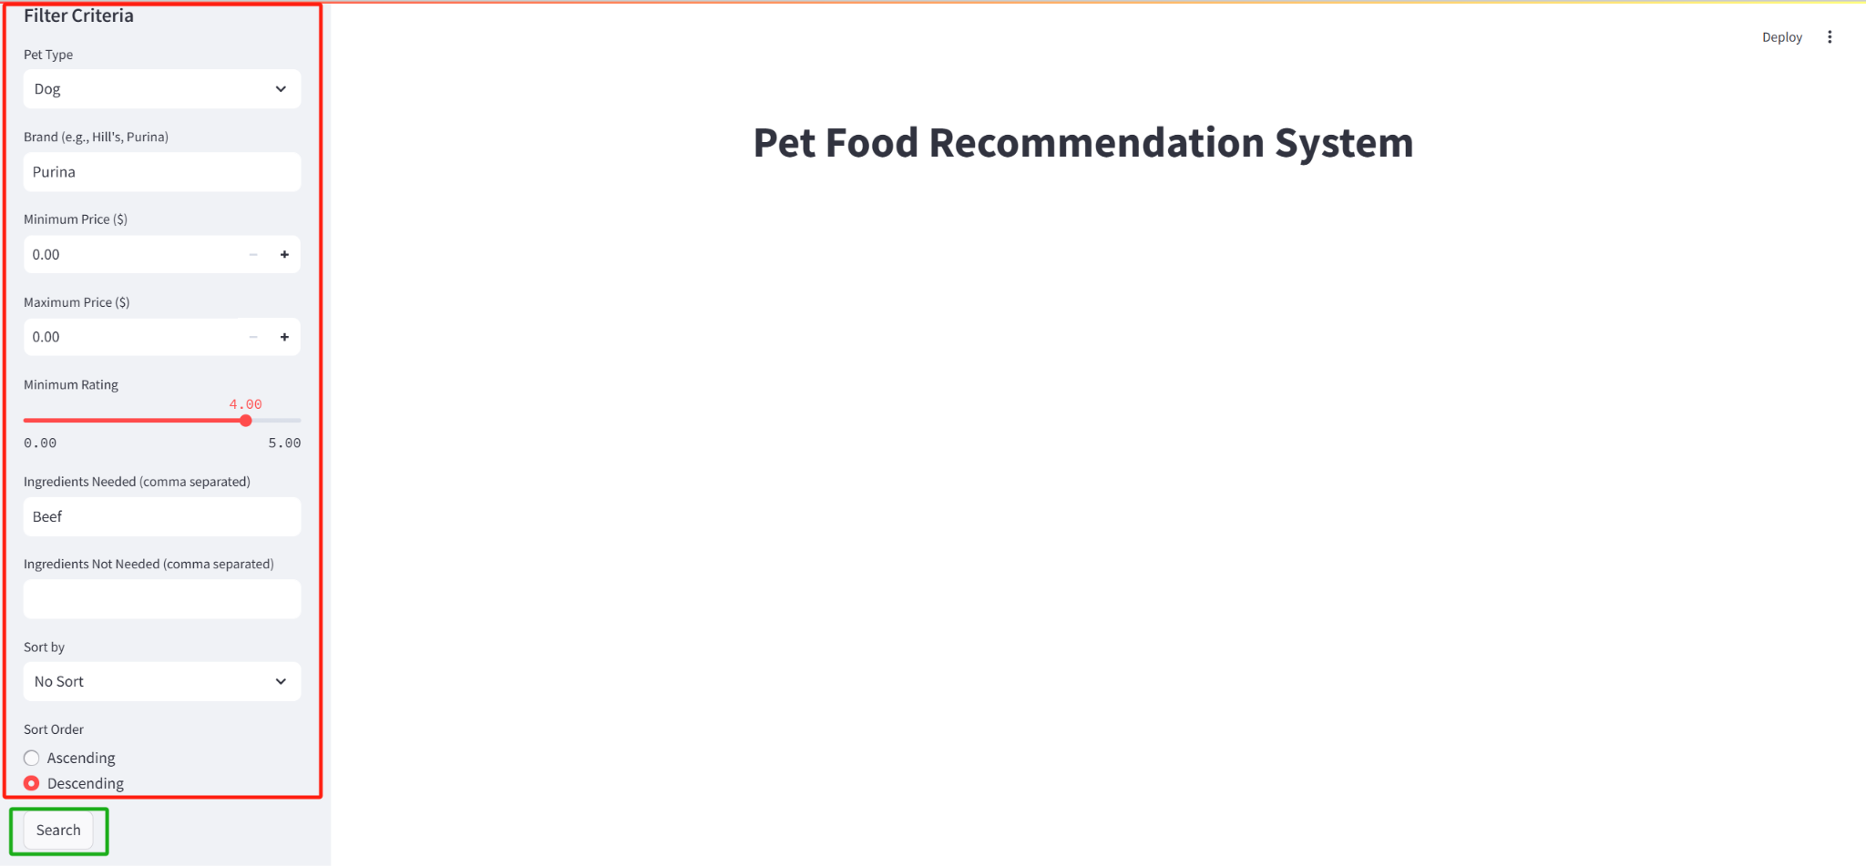
PRODUCT
How it works:
To customize the pet food choice criterias (Dog, Purina Brand, 4+Rating, Beef Contained as Ingredients)

Slide 10
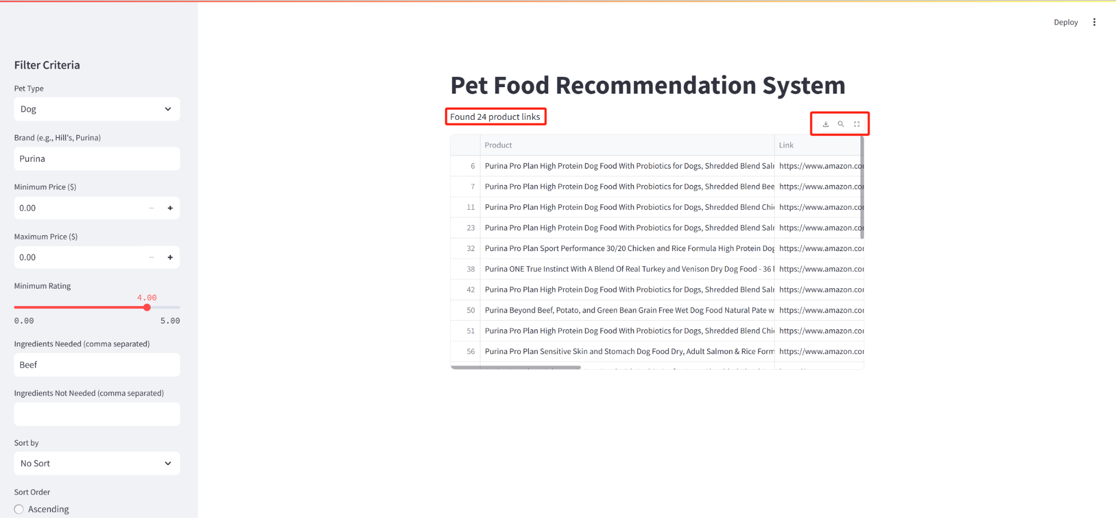
PRODUCT
To retrieve data fulfills the requirements (show how many entries)(3 buttons: download dataframe, search, zoom in)

Slide 11
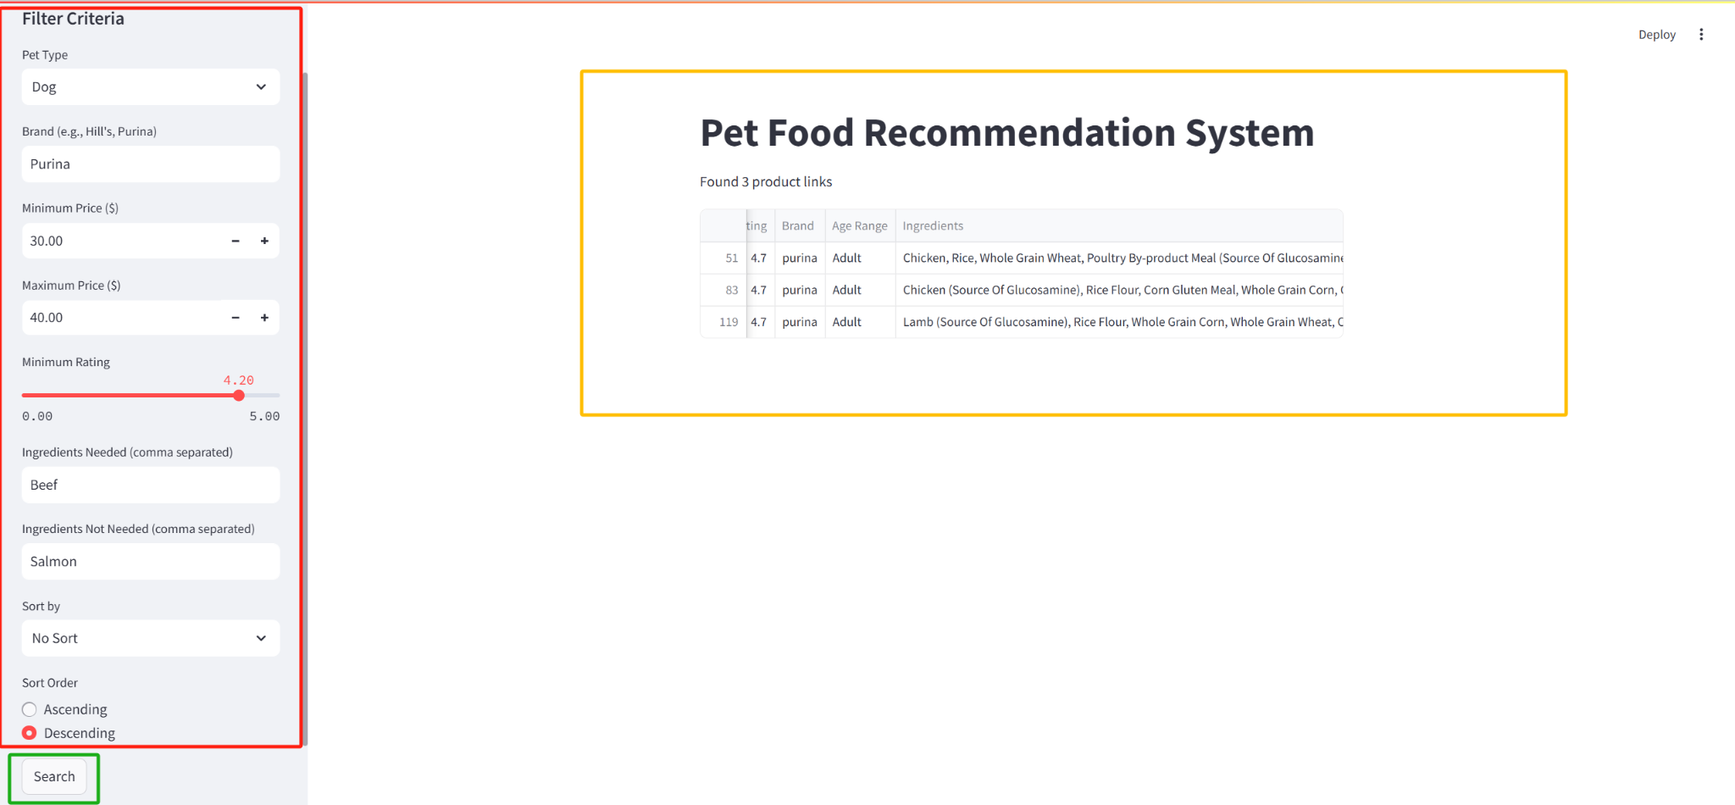
PRODUCT
Use Case (Premium User)

Slide 12
PRODUCT
Data Source:
Amazon
Product Information: Name, Link, Price, Sales, Manufacturer, Ratings, Suitable Age, Ingredients
Reddit
User Reviews: Manufacturer Ratings
Statista
Market Data: Manufacturer Sales Rankings

Slide 13
PRODUCT
Core value proposition：
Personalized Nutrition
Affordability
Convenience
Transparency

Slide 14
PRODUCT
Benefits：
Save time and money
Reduce trial-and-error costs
Cost-effective options
Up-to-date pricing and stock
Better pet health
Lower future vet costs

Slide 15
MARKET target customer
pet owners
who
whose

Slide 16
MARKET target customer
pet daycares and groomers

Slide 17
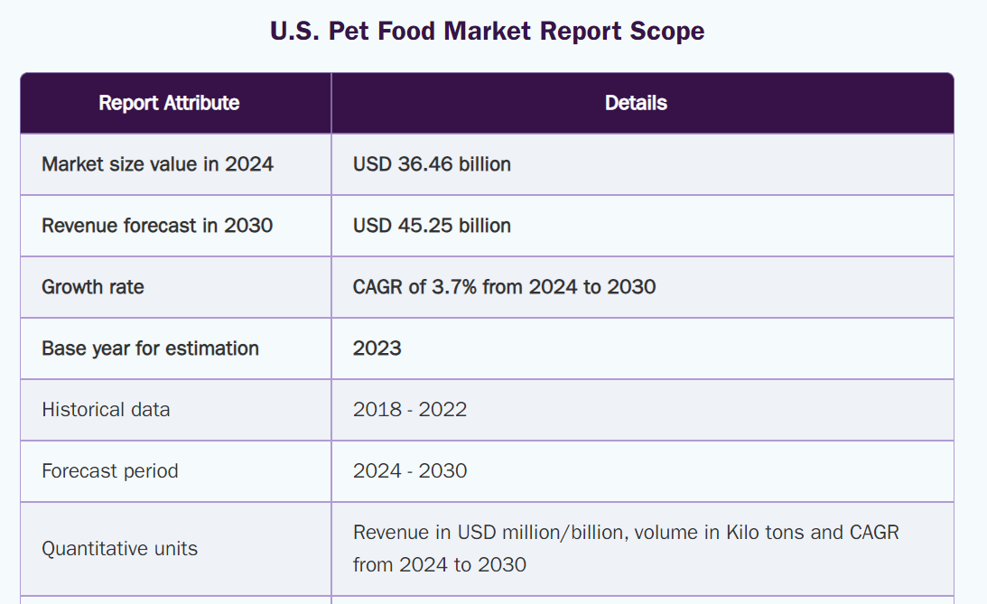
MARKET How big is the market?
(https://www.grandviewresearch.com/industry-analysis/us-pet-food-market-report)

Slide 18
MARKET How big is the market?
launch of new food products
online private brands
pet treats
innovative technologies

Slide 19
MARKET How big is the market?
A growing trend in pet ownership

Slide 20
MARKET How big is the market?
66%

Slide 21
MARKET How big is the market?
$139.8 billion

Slide 22
MARKET What are the market forces / drivers?
Why invest in pet care?

Slide 23
MARKET What are the market forces / drivers?
Why invest in F2?

Slide 24
MARKET What are the market forces / drivers?
Humanization of Pets
Health and Wellness Trends
Technological Advancement
Cost-Conscious Consumer Behavior

Slide 25
MARKET What are the market forces / drivers?
Humanization of Pets:
Pets = Family Members

Slide 26
MARKET What are the market forces / drivers?
Health and Wellness Trends:
Natural ingredients and products address issues

Slide 27
MARKET What are the market forces / drivers?
Technological Advancement:
Advances in data collection and wearable pet devices

Slide 28
MARKET What are the market forces / drivers?
Cost-Conscious Consumer Behavior:
premium + budget-friendly

Slide 29
BUSINESS MODEL / UNIT ECONOMICS
How does the company make money?
Since we are a solution-based company, we have decided to adopt a subscription-based income model.
Pricing details
$30 per year or $4 a month
AOV = $4
We assume customers typically stay subscribed for 4 years
LTV=4×48=182

Slide 30
COMPETITION
Our competitor:
traditional pet food brands
custom meal subscription services for pets

Slide 31
COMPETITION
How are we F2 differentiated?
cost-effective
precise recommendation

Slide 32





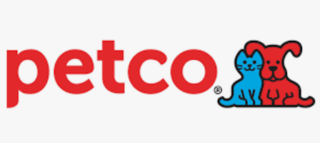

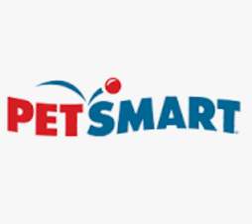
Key Players
Premium
Local
Availability
Nationwide
Coverage
Budget

Slide 33
How are we differentiated?
Personalized Nutrition Plans
customized solution

Slide 34
How are we differentiated?
Budget-Friendly Options
premium and budget-conscious alternatives

Slide 35
How are we differentiated?
Real-Time Pricing & Local Availability
Live pricing
stock availability
buy online or locally

Slide 36
How are we differentiated?
Comprehensive Data Sources
multiple APIs and websites

Slide 37
How are we differentiated?
Transparent Nutritional Data
trusted databases

Slide 38
LAUNCH STRATEGY / GO-TO-MARKET
customer acquisition approach?
We launch digital marketing and social media campaigns, collaborating with online influencers that emphasize the ease of having tailored recommendations without the hassle of researching pet food options.
What are key drivers and potential milestones?
Highlight the affordable $4/month price point compared to other premium options. We plan to hit 1,000 subscribers in the first year of the campaign.

Slide 39
Acquisition Strategy
Digital Marketing
SEO & Content Marketing
Partnerships
Referral Program
Email Marketing

Slide 40
Milestones
Beta Launch (Q2 2025): core features
Partnerships (Q3 2025): collaborations
10,000 Active Users (Q4 2025): user acquisition
Full Product Rollout (Q1 2026): feature set

Slide 41
Thank You!

